Slide 1
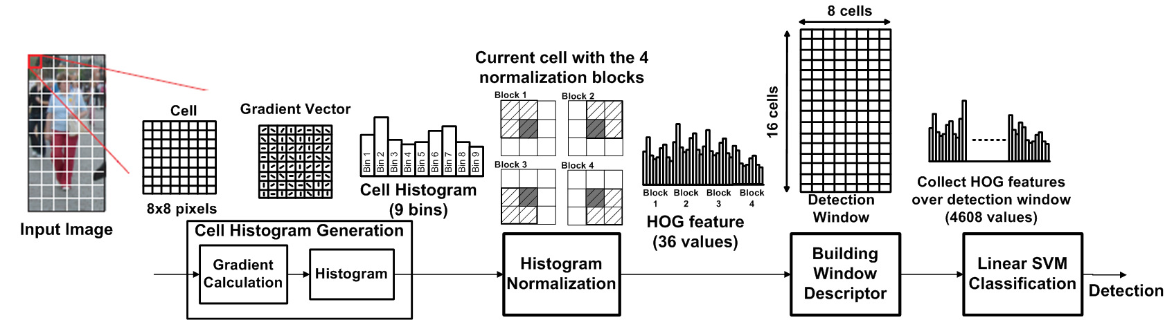
Human detection by HOG
Hardware Architecture
Notes:
Nothing

Slide 2
General Arch
Scan next detection window
Collect HOG feature over detection window
Cell Oriented Histogram
Block Normalization
SVM Classification
Input Image
Results

Slide 3
Gradient
data
[9..0][7..0]
dx
dx
[9..0][7..0]
data RGB
[9..0][2..0][7..0]
RGB2Y
dy
dy
[9..0][7..0]
data
[9..0][7..0]

Slide 4
Cell Oriented Histogram
m2
[22...0]
Hist
9 bins
dx
Histogram Calculation
hist
[8..0][22..0]
DE
MUX2-9
m1
[22..0]
dy
[9..0][7..0]
bin

Slide 5
Dx row
Gradient
Histogram Calculation
M1
(22 bit)
Hist
9 bins
Data
(row = 10 pixel)
DE
MUX2-9
Hist 1 bin
M2
(22 bit)
Dy row
bin

Slide 6



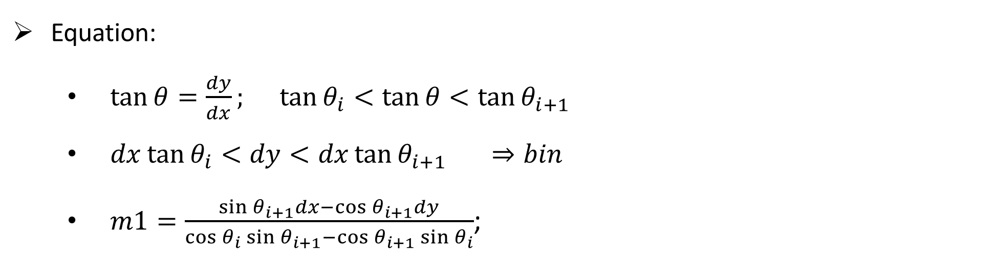



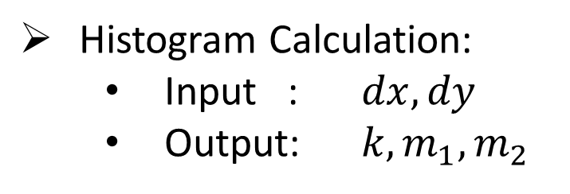










Histogram Calculation
$$bin 4$$
$$bin 3$$
$$bin 5$$
$$bin 2$$
$$bin 6$$
$$θ_{i+1}$$
$$\vec{dy}$$
val
$$θ_{i}$$
$$bin 7$$
$$bin 1$$
Histogram Calculation:
Input : $dx, dy$
Output: $k, m_{1}, m_{2}$
$$\vec{m_{2}}$$
$$\vec{m_{1}}$$
$$bin 8$$
$$\vec{m_{2}}$$
$$bin 0$$
$$θ$$
$$\vec{dx}$$
Equation:
$\tan{θ}=\frac{dy}{dx}; \tan{θ_{i}}<\tan{θ}<\tan{θ_{i+1}}$
$dx\tan{θ_{i}}<dy<dx\tan{θ_{i+1}} ⇒bin$
$m1=\frac{\sin{θ_{i+1}}dx−\cos{θ_{i+1}}dy}{\cos{θ_{i}\sin{θ_{i+1}}−\cos{θ_{i+1}}\sin{θ_{i}}}}$;

Slide 7



























$$y$$
$$y$$
$$\vec{m}$$
$$\vec{m}$$
$$\vec{b_{2}}$$
$$\vec{b_{2}}$$
$$\vec{b_{2}}×\sin{θ_{i+1}}$$
$$\vec{dy}$$
$$\vec{b_{2}}×\sin{θ_{i+1}}$$
$$\vec{dy}$$
$$θ_{i+1}$$
$$\vec{b_{1}}$$
$$\vec{b_{1}}$$
$$\vec{b_{1}}×\sin{θ_{i}}$$
$$θ_{i}$$
$$\vec{b_{1}}×\sin{θ_{i}}$$
$$θ_{i+1}$$
$$θ_{i}$$
$$0$$
$$\vec{dx}$$
$$x$$
$$0$$
$$\vec{dx}$$
$$x$$
$$\vec{b_{2}}×\cos{θ_{i+1}}$$
$$\vec{b_{1}}×\cos{θ_{i}}$$
$$\vec{b_{2}}×\cos{θ_{i+1}}$$
$$\vec{b_{1}}×\cos{θ_{i}}$$

Slide 8
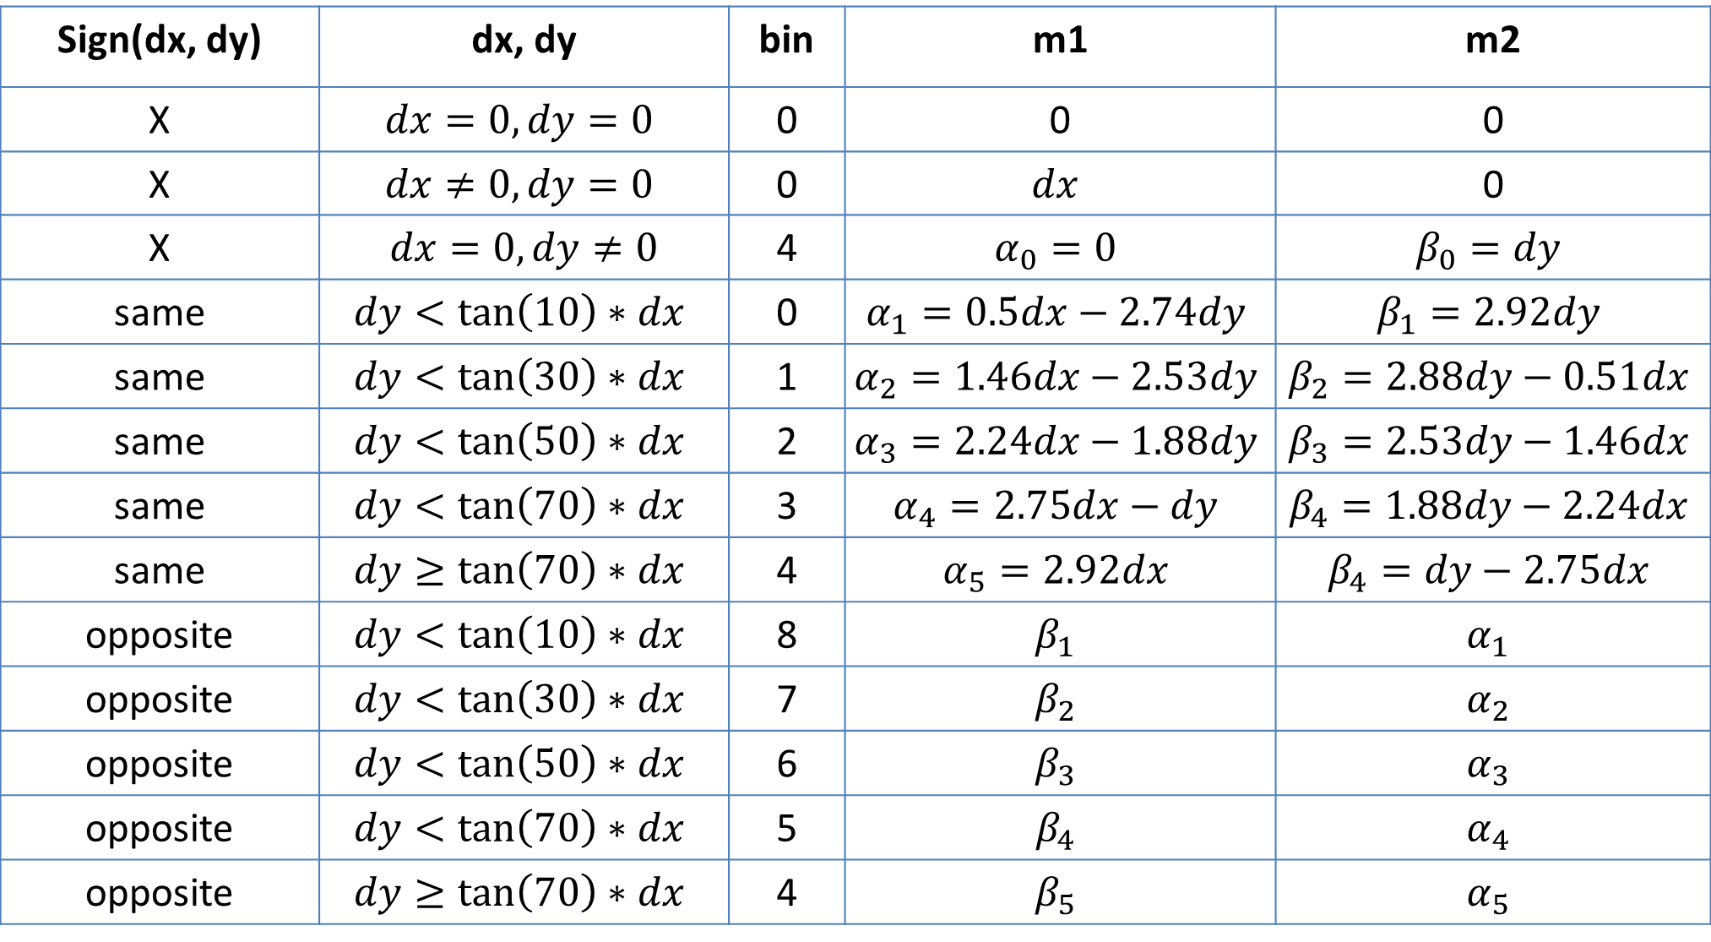
Histogram Calculation
Sign(dx, dy) | dx, dy | bin | m1 | m2
X | $$dx=0, dy=0$$ | 0 | 0 | 0
X | $$dx≠0, dy=0$$ | 0 | $$dx$$ | 0
X | $dx=0, dy≠0$ | 4 | $$α_{0}=0$$ | $$β_{0}=dy$$
same | $$dy<\tan\left(10\right)∗dx$$ | 0 | $$α_{1}=0.5dx−2.74dy$$ | $$β_{1}=2.92dy$$
same | $$dy<\tan\left(30\right)∗dx$$ | 1 | $$α_{2}=1.46dx−2.53dy$$ | $$β_{2}=2.88dy−0.51dx$$
same | $$dy<\tan\left(50\right)∗dx$$ | 2 | $$α_{3}=2.24dx−1.88dy$$ | $$β_{3}=2.53dy−1.46dx$$
same | $$dy<\tan\left(70\right)∗dx$$ | 3 | $$α_{4}=2.75dx−dy$$ | $$β_{4}=1.88dy−2.24dx$$
same | $$dy≥\tan\left(70\right)∗dx$$ | 4 | $$α_{5}=2.92dx$$ | $$β_{4}=dy−2.75dx$$
opposite | $$dy<\tan\left(10\right)∗dx$$ | 8 | $$β_{1}$$ | $$α_{1}$$
opposite | $$dy<\tan\left(30\right)∗dx$$ | 7 | $$β_{2}$$ | $$α_{2}$$
opposite | $$dy<\tan\left(50\right)∗dx$$ | 6 | $$β_{3}$$ | $$α_{3}$$
opposite | $$dy<\tan\left(70\right)∗dx$$ | 5 | $$β_{4}$$ | $$α_{4}$$
opposite | $$dy≥\tan\left(70\right)∗dx$$ | 4 | $$β_{5}$$ | $$α_{5}$$

Slide 9







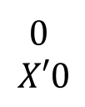










Histogram Calculation
$$dx$$
$$X′0$$
$$dy<\tan\left(80\right)∗dx$$
₀
₁
$$4$$
$$α_{5}$$
$$β_{5}$$
$$dy<\tan\left(60\right)∗dx$$
$$dx$$
$$0$$
$$X′0$$
dx
bin
$$dy<\tan\left(40\right)∗dx$$
$$4$$
$$α_{0}$$
$$β_{0}$$
₀
₁
Sub
$(X^{′}8 −bin$)
₀
₁
m1
$$3$$
$$α_{4}$$
$$β_{4}$$
$$2$$
$$α_{3}$$
$$β_{3}$$
₀
₁
₀
₁
m2
dy
₀
₁
$$1$$
$$α_{2}$$
$$β_{2}$$
₀
₁
$$dy$$
₀
₁
$$0$$
$$α_{1}$$
$$β_{1}$$
$$dx$$
$$dx, dy same sign$$
$$dy<\tan\left(20\right)∗dx$$

Slide 10
Block Normalization
Hist
Divider
DEMUX
HOG Feature
(36-D)
+
Reg1
Sqrt
+
Reg2
+
hist
square
MUX
DEMUX
+
Reg
+
Reg3
+
+
Reg4
Cell Select

Slide 11
Paper name | Technology | Power | Frequency | FPS | Memory | Area+ resolution | Comment
1. Takagi2013as1– A Sub-100 mw Dual-Core HOG Accelerator VLSI for Parallel. Scale 1. | 65 | 99.52 mW | 42.9 | 30 | 1.22Mb (dual-core) | 3.3×1.2 | Cell Hist generation : 46.8% cycle count 0.67 x10^6 clk / HDTV
2. beneson2012 – Pedestrian detection at 100 frames per second |  |  | 135 | 100 |  | 640 × 480 | CPU+GPU. CPU runs at 145 Hz, CPU at 135 Hz.
3. mizuno2012aso – Architectural Study of HOG Feature Extraction Processor for Real-Time Object Detection | 60 |  | 76.2 | 30 | 630kb | 1920x1080 | Cell Hist generation: 56% workload 1.3x10^6 clk / HDTV
4. negy2011dp – Deep pipelined one-chip FPGA implementation of a real-time image-based human detection algorithm | 65 |  | 44.85 | 62.5 |  | 640×480 | Have approximate bin cell generation & Esenormalization by shift.
5. kelly2014hoo – Histogram of oriented gradients front end processing: An FPGA based processor approach. With IPPRO 90-cores (Zynq 7020). Have timing. | 28 | 3.6 W | 404 MHZ (90 cores) | 23 |  | 1920x1080. Used 16 IPPro cores. | Cell Hist generation: 0.39us / 6pixel + 0.49us/ 5pixel 135ms / HD + 204ms / HD 288MHz + 164 MHz
6. landola2015lee – libHOG: Energy-Efficient Histogram of Oriented Gradient Computation. |  |  | 135 | 70 |  | 640x480 | Use arctan LUT.
7. suleiman2014aee -- An Energy-Efficient Hardware Implementation of HOG-Based Object Detection at 1080HD 60 fps with Multi-Scale Support | 45 | 45.3 mW | 270 | 60 | 0.538Mb | 2.8×0.96 | Cell Hist generation: Input: 8.2 bit / cycle Output: 1.6 bit / cycle
9. hahnle2013fbr – FPGA-based Real-Time Pedestrian Detection on High-Resolution Images |  |  | 270 | 64 | 1188kb | 1920x1080 | g
X. OURS2017hnf – HOG non-normalized feature extraction with only shift and addition operators | 45 |  | 400 (only cell hist) |  |  |  | Reduce Gradient Cal. ?% workload & ?% cycle count.

Slide 12
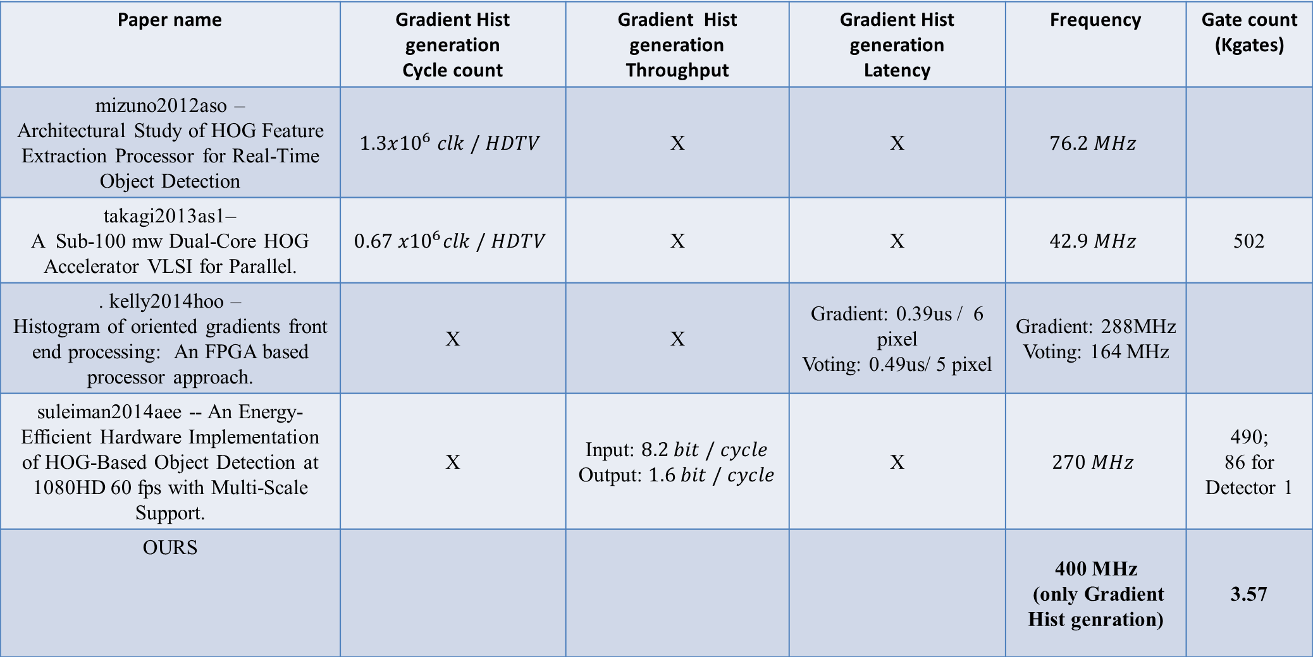
Paper name | Gradient Hist generation Cycle count | Gradient Hist generation Throughput | Gradient Hist generation Latency | Frequency | Gate count (Kgates)
mizuno2012aso – Architectural Study of HOG Feature Extraction Processor for Real-Time Object Detection | $$1.3x{10}^{6} clk / HDTV$$ | X | X | $$76.2 MHz$$
takagi2013as1– A Sub-100 mw Dual-Core HOG Accelerator VLSI for Parallel. | $$0.67 x{10}^{6}clk / HDTV$$ | X | X | $$42.9 MHz$$ | 502
. kelly2014hoo – Histogram of oriented gradients front end processing: An FPGA based processor approach. | X | X | Gradient: 0.39us / 6 pixel Voting: 0.49us/ 5 pixel | Gradient: 288MHz Voting: 164 MHz
suleiman2014aee -- An Energy-Efficient Hardware Implementation of HOG-Based Object Detection at 1080HD 60 fps with Multi-Scale Support. | X | Input: $8.2 bit / cycle$ Output: $1.6 bit / cycle$ | X | $$270 MHz$$ | 490; 86 for Detector 1
OURS |  |  |  | 400 MHz (only Gradient Hist genration) | 3.57

Slide 13
Paper name | Feature | Comment
Karakaya2009 - Implementation of HOG algorithm for Real Time Object Recognition Applications on FPGA based Embedded System | Piece-wise | Tieng nuoc khac
Gu2013 - Fast FPGA-Based Multiobject Feature Extraction | LUT | Kho hieu, dung label thay vi lut
An Efficient Hardware Implementation of HOG Feature Extraction for Human Detection | Xap xi acrtan, magnitude, vote, norm | Accracy is not change
FLOATING POINT HOG IMPLEMENTATION FOR REAL-TIME MULTIPLE OBJECT DETECTION |  | Module Gradient thuc thi voi 25MHz (minimum)

Slide 14
 |  | Frequency in phase 1 (MHz) | Gate count (Kgates) | Throughput in phase 1 (bit/ns) | Reduce accuracy
Chen [11] |  | 42.9 | 502 for all | X | 0.30.49%
Kelly’s [10] | Gradient | 288 | X | 0.123
 | Voting | 164 | X | 0.082
Suleiman’s [9] |  | 270 | 86 for Detector 1 | 0.432
Ours |  | 400 | 3.57 for phase 1 | 3.2

Slide 15
Gate count (Kgates) | HOG [10] | HOG [11] | proposed HOG
Gradient & Magnitude | 0.51 | 1.25 | 3.57
Gradient vote | 86.95 | 27.87

Slide 16
THE END
Thanks for watching

Slide 17
Kiến trúc chung
Quét cửa sổ tiếp theo
Lưu trữ HOG cho cửa sổ tiếp theo
Quét và tính toán Gradient
Tính HOG cho khối 8x8
Chuẩn hóa HOG khối 16x16
Phân loại SVM
Ảnh
đầu vào
Kết quả
phân loại

Slide 18
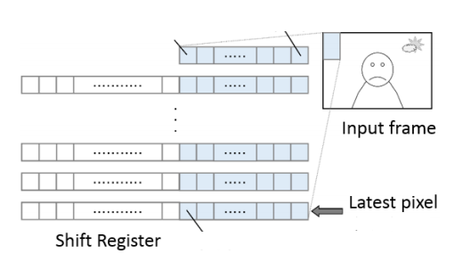
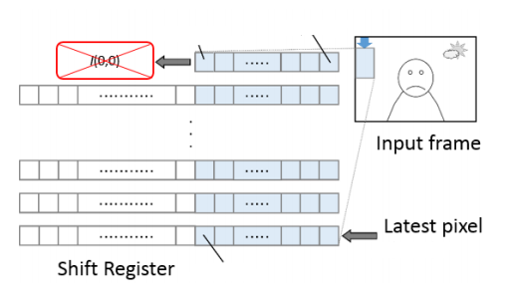
Cell Input Generation
Cell
10x10
SDRAM
640x480 RGB image
MUX
Window image
130x66
Block
18x18
Cell
10x10
Pixels RGB
10x10
Cell
10x10
Cell
10x10
Cell Input Generation

Slide 19
Cell Input Generation
Cell
10x10
SDRAM
640x480 RGB image
MUX
Window image
130x66
Block
18x18
Cell
10x10
Pixels RGB
10x10
Cell
10x10
Cell
10x10
Cell Input Generation

Slide 20



Cell Histogram Generation
Histogram
Buffer SRAM
10x10
dx
Magnitude
8x8
8x8
RGB
To Gray
Histogram
9 bins
Pixels RGB
10x10
dy
Angles
8x8
10x10
8x8
Cell Histogram Generation

Slide 21
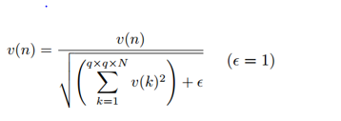
Histogram Normalization
9 bins
Divider
DEMUX
HOG Feature
(36-D)
9 bins
Sqrt
MUX
(.)²
+
Reg
+
Reg
Histogram Normalization

Slide 22
Histogram Normalization
9 bins
Bộ chia
DEMUX
Đặc trưng HOG
(36-D)
9 bins
Bộ căn
MUX
(.)²
+
Reg
+
Reg

Slide 23
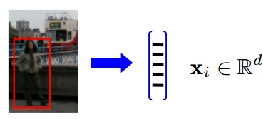

SVM Classification
Control Unit
SVM trained
SRAM
Convolution
Parallel
Accumulation SRAM
HOG Feature
(36-D)
+

Slide 24
SVM Classification
Bộ điều khiển
SVM đã đào tạo (SRAM)
Nhân chập song song – nối tiếp
Bộ tích lũy (SRAM)
Đặc trưng HOG
(36-D)
+

Slide 25
Processing
HOG Cell 1
Histogram Normalization
Cell Input Generation
HOG Cell 2
HOG Feature
(36-D)
Cell Histogram Generation
HOG Cell 3
Shift register
Cell 3
MUX
HOG Cell 4
Cell 4

Slide 26
Mult parallel
HOG 1
HOG 9
Đặc trưng HOG
(36-D)
HOG 4
HOG 12
*
*
SVM 1
SVM 9
SVM 4
SVM 12
+
+
HOG 5
HOG 13
SVM đã đào tạo
(SRAM)
+
HOG 8
HOG 16
*
*
SVM 5
SVM 13
SVM 8
SVM 16

Slide 27







LUT
Magnitude
LUTs
dx
$$dx$$
Calculate magnitude
magnitude
$$dx$$
Comparator
$$dy$$
$$X^{′}F$$
$$dy$$
Comparator
dy
angle
$$X^{′}F$$
$$dx$$
Calculate angle
$$dy$$
Angle
LUTs

Slide 28
LUT
LUT của biên độ
dx
>
$$dx$$
Tính toán biên độ
Biên độ
$$dx$$
So sánh
$$dy$$
$$X^{′}F$$
$$dy$$
So sánh
dy
Góc
$$X^{′}F$$
$$dx$$
Tính toán góc
>
$$dy$$
LUT của góc

Slide 29
Reference
Finding People in Images and Videos – Navneet DALAL
An Energy-efficient Hardware Implementation of HOG-based - Amr Suleiman · Vivienne Sze

